Slide 1
Artificial Intelligence
Chapter Three:
Searching and Planning

Slide 2
Objectives
After successfully completing this unit, you should be able to:
understand the concept of problem-solving through searching and planning;
explore the basics of Constraint Satisfaction Problems and their relevance in problem-solving;
learn about Problem Solving Agents and their characteristics;
understand the concept of problem spaces and how search algorithms can be used to navigate them;
examine the relationship between knowledge and rationality in problem-solving agents;
explore different heuristic search strategies and their applications;
understand the concept of search and optimization, particularly gradient descent;
learn about adversarial search and its significance in competitive scenarios;
explore planning and scheduling techniques and their role in problem-solving;
understand the importance of avoiding repeated states in search algorithms.

Slide 3
3.1 Solving Problems by searching and Planning
What is Problem ?
It is a gap between what actually is and what is desired.
A problem exists when an individual becomes aware of the existence of a significant difference between the expected and the actual situation, which is an obstacle and makes it difficult to achieve a desired goal or objective.
Solving problems through searching and planning is a fundamental concept in the field of artificial intelligence (AI).
It involves developing algorithms and techniques that enable AI systems to find optimal or near-optimal solutions to complex problems.

Slide 4
3.2 Constraint Satisfaction Problem
A Constraint Satisfaction Problem (CSP) is a fundamental concept in the field of artificial intelligence, particularly in the context of searching and planning.
CSPs provide a framework for modeling and solving problems where a set of variables must be assigned values while satisfying a set of constraints.
It has a wide-range of applications in various domains, including scheduling, resource allocation, configuration, and more and it involves :
Problem Representation
Variables and Domains
Constraints
Solving CSP’s etc.

Slide 5
3.3 Problem Solving Agents
Four general steps in problem solving:
Goal formulation
What are the successful world states
Problem formulation
What actions and states to consider given the goal
Search
Determine the possible sequence of actions that lead to the states of known values and then choosing the best sequence.
Execute
Give the solution perform the actions.

Slide 6
Problem-solving agent
function SIMPLE-PROBLEM-SOLVING-AGENT(percept) return an action
static: seq, an action sequence
state, some description of the current world state
goal, a goal
problem, a problem formulation
state ← UPDATE-STATE(state, percept)
if seq is empty then
goal ← FORMULATE-GOAL(state)
problem ← FORMULATE-PROBLEM(state,goal)
seq ← SEARCH(problem)
action ← FIRST(seq)
seq ← REST(seq)
return action
A simple problem-solving agent.
It first formulates a goal and a problem, searches for a sequence of actions that would solve the problem, and then executes the actions one at a time.
When this is complete, it formulates another goal and starts over.
Note that when it is executing the sequence it ignores its percepts: it assumes that the solution it has found will always work.

Slide 7
Problem Solving Agent cont’d
A problem can be defined formally by four components
The initial state (the agent starts in)
A description of the possible actions (uses successor function)
The goal test which determines whether a given state is a goal state
A path cost is function that assigns a numeric cost to each path (distance, etc)
Together, the initial state and successor function implicitly define the state space of the problem-the set of all states reachable from the initial state.
Path in the state space is a sequence of states connected by a sequence of actions.

Slide 8
Problem Solving Agent cont’d
A solution to a problem is a path from the initial state to a goal state. Solution quality is measured by the path cost function, and an optimal solution has the lowest path cost among all solutions.
Type of agent that solve problem by searching
Such agent is not reflex or model based reflex agent because this agent needs to achieve some target (goal)
It can be goal based or utility based or learning agent
Intelligent agent knows that to achieve certain goal, the state of the environment will change sequentially and the change should be towards the goal
Intelligent agents are supposed to maximize their performance measure

Slide 9
Problem Solving Agent…cont’d
Assume a problem is to reach specified place (location) as it is indicated on the following slide
A problem is defined by:
An initial state, e.g. Arad
Successor function S(X)= set of action-state pairs
e.g. S(Arad)={<Arad → Zerind, Zerind>,…}
intial state + successor function = state space
Goal test, can be
Explicit, e.g. x=‘at bucharest’
Implicit, e.g. checkmate(x)
Path cost (additive)
e.g. sum of distances, number of actions executed, …
c(x,a,y) is the step cost, assumed to be >= 0
A solution is a sequence of actions from initial to goal state.
Optimal solution has the lowest path cost.

Slide 10
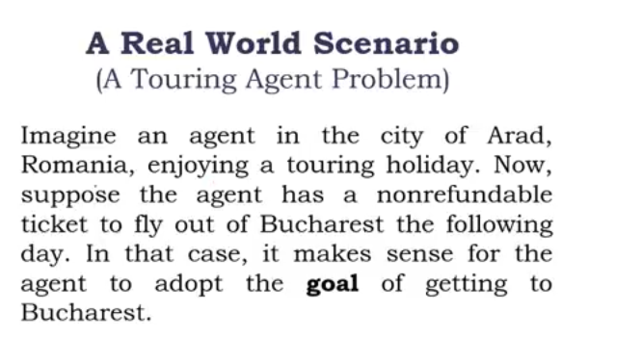
Problem Solving Agent cont’d

Slide 11
Problem…contd
States
Actions
Start
Solution
Goal

Slide 12
Problem Solving Agent cont’d
In the preceding section we proposed a formulation of the problem of getting to Bucharest in terms of the initial state, successor function, goal test, and path cost.
This formulation seems reasonable, yet it omits a great many aspects of the real world. Real world is absurdly complex.
The state of the world (state description) includes so many things for example , :
The traveling companions,
What is on the radio,
The scenery out of the window,
Whether there are any law enforcement officers nearby,
How far lit is to the next rest stop,
The condition of the road, the weather, and so on.

Slide 13
Problem Solving Agent cont’d
All these considerations are left out of our state descriptions because they are irrelevant to the problem of finding a route to Bucharest.
The process of removing detail from a representation is called abstraction.
In addition to abstracting the state description, we must abstract the actions themselves.
A driving action has many effects.
Besides changing the location of the vehicle and its occupants, it takes up time, consumes fuel, generates pollution, and changes the agent (as they say, travel is broadening).
In formulation, in our example, we take into account only the change in location.

Slide 14
Problem formulation
For vacuum world problem, the problem formulation involve:
States: The agent is in one of two locations, each of which might or might not contain dirt. Thus there are 2 x 2^2 = 8 possible world states.
Initial state: Any state can be designated as the initial state.
Successor function: This generates the legal states that result from trying the three actions (Left, Right, and Suck).
Goal test: This checks whether all the squares are clean.
Path cost: Each step costs 1, so the path cost is the number of steps in the path.

Slide 15
Goal formation cont’d
Goal formulation: refers to the understanding of the objective of the agent based on the state description of the final environment
For example, for the vacuum world problem, the goal can be formulated as [clean, Clean, agent at any block]

Slide 16

Problem Solving Agent cont’d
In problem solving by searching, solution can be described into two ways.
Solution can be provided as state sequence or action sequence
For example consider the vacuum cleaner world with initial state as shown bellow
Solution as state sequence becomes:
Suck Move Right
In general, an agent with several immediate options of unknown value can decide what to do by first examining different possible sequences of actions that lead to states of known value, and then choosing the best sequence.

Slide 17
Problem Solving Agent cont’d
This process of looking for such a sequence is called search.
A search algorithm takes a problem as input and returns a solution in the form of an action sequence.
Once a solution is found, the actions it recommends can be carried out. This is called the execution phase.
Thus, we have a simple "formulate, search, execute" design for the agent

Slide 18
Example: Road map of Ethiopia
Problem solving agent cont’d
Aksum
100
200
Mekele
Gondar
180
80
Lalibela
110
250
150
Bahr dar
Dessie
170
Debre markos
330
Dire Dawa
230
330
400
Jima
Addis Ababa
100
430
Adama
370
Gambela
230
320
Nekemt
Awasa

Slide 19
Example: Road map of Ethiopia
Problem Solving agent cont’d
Current position of the agent (Initial State): Awasa.
Needs to arrive to: Gondar
Formulate goal: be in Gondar
Formulate problem:
states: various cities
actions: drive between cities
Find solution:
sequence of cities, e.g., Awasa, Adama, Addis Ababa, Dessie, Godar

Slide 20
Types of Problems
Four types of problems exist in the real situations:
Single-state problem
The environment is Deterministic and fully observable
Out of the possible state space, agent knows exactly which state it will be in; solution is a sequence
2. Sensor less problem(conformant problem)
The environment is non-observable
It is also called multi-state problem
Agent may have no idea where it is; solution is a sequence

Slide 21
Types of Problems cont’d
3. Contingency problem
The environment is nondeterministic and/or partially observable
It is not possible to know the effect of the agent action
percepts provide new information about current state
4. Exploration problem
The environment is partially observable
It is also called unknown state space

Slide 22
Problem type as a summery cont’d
Environment Type | Problem Type
Deterministic, fully-observable | Single-state problem
Non-observable, known state space | Sensorless/conformant problem
Nondeterministic and/or partially-observable | Contingency problem
Partially observable, unknown state space | Exploration problem

Slide 23
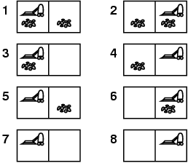
Example: vacuum world
Vacuum Cleaner World Example cont’d
Single-state
Starting state us known say in #5.
What is the Solution?

Slide 24



Example: vacuum world
Vacuum Cleaner World Example cont’d
Single-state, start in #5. Solution? [Right, Suck]

Slide 25
Example: vacuum world
Vacuum Cleaner World Example cont’d
Sensorless,
It doesn’t know what the current state is
So the current start is either of the following: {1,2,3,4,5,6,7,8}
What is the Solution?

Slide 26
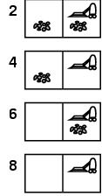
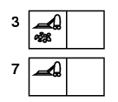
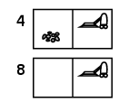

Example: vacuum world
Vacuum Cleaner World Example cont’d
Sensorless
Solution
Right goes to {2,4,6,8} Solution?
[Right,Suck,Left,Suck]

Slide 27
Example: vacuum world
Vacuum Cleaner World Example cont’d
Contingency
Nondeterministic:
- Suck may dirty a clean carpet
Partially observable:
- Hence we have partial information
Let’s assume the current percept is: [L, Clean] i.e. start in #5 or #7
What is the Solution?

Slide 28
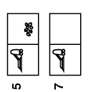



Example: vacuum world
Vacuum Cleaner World Example cont’d
Contingency
Solution
[Right, if dirt then Suck]
Move right
suck

Slide 29
Vacuum Cleaner World Example cont’d
Real-world Problems to be solved by searching algorithms
We have seen two such problems:
The road map problem and the vacuum cleaner world problem
Route finding
Touring problems
VLSI layout
Robot Navigation
Automatic assembly sequencing
Drug design
Internet searching

Slide 30
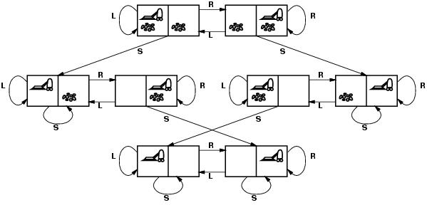
Example: vacuum world
Vacuum Cleaner World Example cont’d
States??
Initial state??
Actions??
Goal test??
Path cost??

Slide 31
Example: vacuum world
Vacuum Cleaner World Example cont’d
States?? two locations with or without dirt: 2 x 2²=8 states.
Initial state?? Any state can be initial
Actions?? {Left, Right, Suck}
Goal test?? Check whether squares are clean.
Path cost?? Number of actions to reach goal.

Slide 32
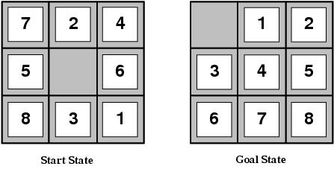
Example: 8-puzzle
States??
Initial state??
Actions??
Goal test??
Path cost??

Slide 33
Example: 8-puzzle cont’d
States?? Integer location of each tile
Initial state?? Any state can be initial
Actions?? {Left, Right, Up, Down}
Goal test?? Check whether goal configuration is reached
Path cost?? Number of actions to reach goal

Slide 34
Example: 8-puzzle cont’d
8
2
1
2
3
3
4
7
4
5
6
5
1
6
7
8
Initial state
Goal state

Slide 35
Example: 8-puzzle cont’d
8
2
7
3
4
8
2
5
1
6
3
4
7
5
1
6
8
2
8
2
3
4
7
3
4
7
5
1
6
5
1
6

Slide 36
Example: 8-puzzle cont’d
Size of the state space = 9!/2 = 181,440
15-puzzle → .65 x 10¹²
24-puzzle → .5 x 10²⁵
0.18 sec
6 days
12 billion years
10 million states/sec

Slide 37
Example: 8-queens cont’d
Place 8 queens in a chessboard so that no two queens are in the same row, column, or diagonal.
A solution
Not a solution

Slide 38
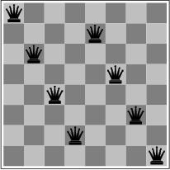
Example: 8-queens problem cont’d
Incremental formulation vs. complete-state formulation
States??
Initial state??
Actions??
Goal test??
Path cost??

Slide 39
Example: 8-queens cont’d
Formulation #1:
States: any arrangement of 0 to 8 queens on the board
Initial state: 0 queens on the board
Actions: add a queen in any square
Goal test: 8 queens on the board, none attacked
Path cost: none
→ 64⁸ states with 8 queens

Slide 40
Example: 8-queens cont’d
Formulation #2:
States: any arrangement of k = 0 to 8 queens in the k leftmost columns with none attacked
Initial state: 0 queens on the board
Successor function: add a queen to any square in the leftmost empty column such that it is not attacked by any other queen
Goal test: 8 queens on the bord
→ 2,067 states

Slide 41
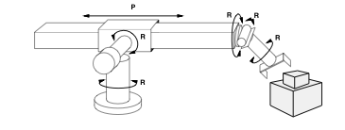
Example: robot assembly
States??
Initial state??
Actions??
Goal test??
Path cost??

Slide 42
Example: robot assembly cont’d
States?? Real-valued coordinates of robot joint angles; parts of the object to be assembled.
Initial state?? Any arm position and object configuration.
Actions?? Continuous motion of robot joints
Goal test?? Complete assembly (without robot)
Path cost?? Time to execute

Slide 43
3.4 Search Space and Heuristic Search Strategies Searching For Solution (Tree search algorithms)
Given state space, and network of states via actions.
The network structure is usually a graph
Tree is a network in which there is exactly one path defined from the root to any node
Given state S and valid actions being at S
the set of next state generated by executing each action is called successor of S
Searching for solution is a simulated exploration of state space by generating successors of already-explored states

Slide 44
Searching For Solution (Tree search algorithms)
A state is a (representation of) a physical configuration
A node is a data structure constituting part of a search tree
It includes:
state,
parent node,
action,
depth and
one or more costs [like path cost g(x), heuristic cost h(x), evaluation function cost f(x)]

Slide 45
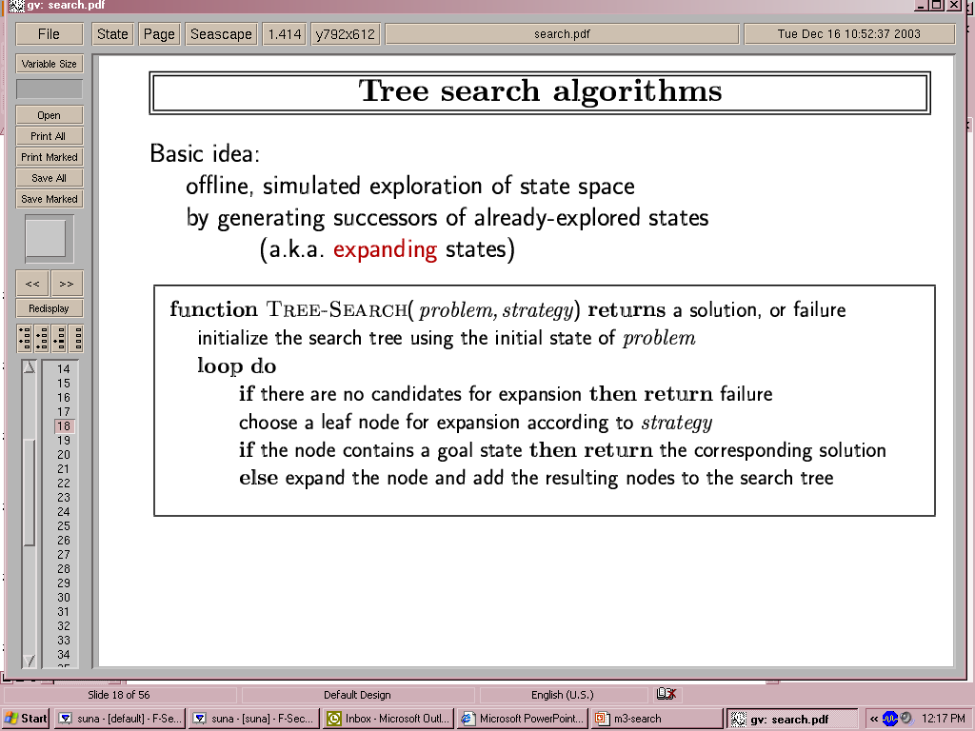
Searching For Solution (Tree search algorithms)
The Successor-Fn generate all the successors state and the action that leads moves the current state into the successor state
The Expand function creates new nodes, filling in the various fields of the node using the information given by the Successor-Fn and the input parameters

Slide 46
Searching For Solution (Tree search algorithms)
A search process can be viewed as building a search tree over the state space
Search tree is a tree structure defined by initial state and a successor function.
Search(root) Node is the root of the search tree representing initial state and without a parent.
A child node is a node adjacent to the parent node obtained by applying an operator or rule.

Slide 47
Tree search example
Tree search example cont’d
Awasa
Adama
Addis Ababa
Gambela
Gambela
AA
Dire Dawa
Adama
Nekemt
Debre Markos
Awasa
Jima
Awasa
Dessie
AA
Gondar
BahrDar
AA
Lalibela
Gondar
Debre M.

Slide 48
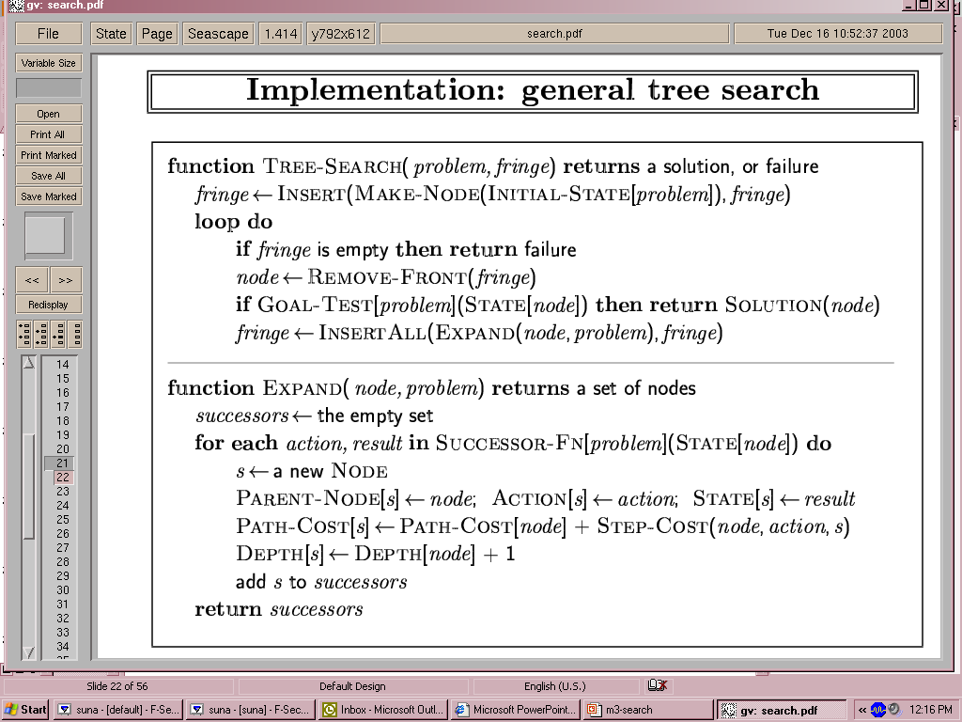
Implementation: general tree search
General tree search cont’d

Slide 49
Search strategies cont’d
A search strategy is defined by picking the order of node expansion
Strategies are evaluated along the following dimensions:
completeness: does it always find a solution if one exists?
time complexity: number of nodes generated
space complexity: maximum number of nodes in memory
optimality: does it always find a least-cost solution?
Time and space complexity are measured in terms of
b: maximum branching factor of the search tree
d: depth of the least-cost solution
m: maximum depth of the state space (may be ∞)
Generally, searching strategies can be classified in to two as uninformed and informed search strategies

Slide 50
Uninformed search (blind search) strategies
Uninformed search strategies (Blind Search)
use only the information available in the problem definition
They have no information about the number of steps or the path cost from the current state to the goal
They can distinguish the goal state from other states
They are still important because there are problems with no additional information.
Six kinds of such search strategies will be discussed and each depends on the order of expansion of successor nodes.
Breadth-first search
Uniform-cost search
Depth-first search
Depth-limited search
Iterative deepening search
Bidirectional search

Slide 51
Uninformed search (blind search) strategies
d
m
b
G

Slide 52
Generating action sequences- search trees
Leaf Node: is a node without successors ( or children).
They have not been expanded yet or because they were expanded before.
Depth (d): of a node is the number of actions required to reach it from the initial state.
Frontier or Fringe Nodes: are the collection of nodes that are waiting to be expanded.
Path cost: of a node is the total cost leading to this node.
Branch Factor(b): Max. number of successors for any node.

Slide 53
Breadth-first search
Uses no prior information, nor knowledge
It tracks all nodes because it does not know whether this node leads to a goal or not
Keeps on trying until it gets solution
All nodes are expanded from the root node
That is it is a simple strategy in which
the root node is expanded first,
then all the successors of the root node are expanded next,
then their successors, and so on.

Slide 54
Breadth first search cont’d
In general, all the nodes are expanded at a given depth in the search tree before any nodes at the next level are expanded.
That is, BFS expands all nodes at level d before expanding nodes at level d+1
It checks all paths of a given length before moving to any longer path
Expands the shallowest node first

Slide 55
Breadth first search cont’d
The figure shows the progress of the search on a simply binary tree BFS trees after 0, 1, 2, 3, and 4 nodes expansion

Slide 56
Breadth first search…cont’d
S
A
D
B
D
A
E
Move downwards, level by level, until goal is reached.
C
E
E
B
B
F
D
F
B
F
C
E
A
C
G
G
C
G
F
G

Slide 57
Breadth first search cont’d
Algorithm for Breadth-first search(FIFO)
Blind search in which the list of nodes is a queue
To solve a problem using breadth-first search:
1.Set L to be a list of the initial node in the problem.
2.If L is empty, return failure otherwise pick the first node n from L
3.If n is a goal state, quit and return the path from initial node to n
4.Otherwise remove n from L and add to the end of L all of n's children. Label each child with its path from initial node
5.Return to 2.

Slide 58
Algorithm for Breadth-first search(FIFO)
Breadth first search cont’d
BFS can be implemented using a queuing function that puts the newly generated states at the end of the queue, after all previously generated states
1. QUEUE <-- path only containing the root;
2. WHILE QUEUE is not empty
AND goal is not reached
DO remove the first path from the QUEUE;
create new paths (to all children);
reject the new paths with loops;
add the new paths to back of QUEUE;
3. IF goal reached
THEN success;
ELSE failure;

Slide 59
Properties of breadth-first search
Breadth first search cont’d
Complete? Yes (if b is finite, which is true in most cases)
Time? 1+b+b²+b³+… +b^{d} = O(b^{d+1})
at depth value = i , there are b^{i} nodes expanded for i ≤d
Space? O(b^{d}) (keeps every node in memory)
a maximum of this much node will be there while reaching to the goal node
This is a major problem for real problem
Optimal? Yes (if cost = constant (k) per step)
Space is the bigger problem (more than time)

Slide 60
Using the same hypothetical state space find the time and memory required for a BFS with branching factor b=10 and various values of the solution depth d
Breadth first search cont’d

Slide 61
Depth-first Search (DFS)
Pick one of the children at every node visited, and work forward from that child
Always expands the deepest node reached so far (and therefore searches one path to a leaf before allowing up any other path)
Thus, it finds the left most solution

Slide 62
Depth-first search- Chronological backtracking
Depth-first Search cont’d
S
Select a child
convention: left-to-right or may be alphabetical order
Repeatedly go to next child, as long as possible.
Return to left-over alternatives (higher-up) only when needed.
A
B
D
C
E
D
F
G

Slide 63
Depth-first search cont’d
Depth-first search(LIFO) algorithm
1. STACK <-- path only containing the root;
2. WHILE STACK is not empty
AND goal is not reached
DO remove the first path from the STACK;
create new paths (to all children);
reject the new paths with loops;
add the new paths to front of STACK;
3. IF goal reached
THEN success;
ELSE failure;

Slide 64
Depth-first search cont’d
Complete: Yes, if state space finite
No, if state contains infinite paths or loops
Time: O(b^{m})
Space: O(bm) or O(bm+1) (i.e. linear space)
Optimal : No
Then the worst case time complexity is O(b^{m})
However, for very deep (or infinite due to cycles) trees this search may spend a lot of time (forever) searching down the wrong branch
Backtracking search uses even less memory, one successor instead of all b.

Slide 65
Depth-first search cont’d
Time Requirements of Depth-First Search
It is also more likely to return a solution path that is longer than the optimal
Because it may not find a solution if one exists, this search strategy is not complete.
Remarks: Avoid DFS for large or infinite maximum depths.

Slide 66
Depth-Limited Strategy(Depth first search with cut off)
Depth-first with depth cutoff k (maximal depth below which nodes are not expanded)
Three possible outcomes:
Solution
Failure (no solution)
Cutoff (no solution within cutoff)
Solves the infinite-path problem.
If k< d then incompleteness results.
If k> d then not optimal.
Time complexity: O(b^{k})
Space complexity O(bk)

Slide 67
DFS Evaluation:
Depth-Limited Strategy(Depth first search with cut off)
DFS is a method of choice when there is a known (and reasonable) depth bound, and finding any solution is sufficient
Depth-first search:
IF the search space contains very deep branches without solution, THEN Depth-first may waste much time in them.
2. Breadth-first search:
Is VERY demanding on memory !
Solutions ??
Iterative deepening
The order of expansion of states is similar to BFS, except that some states are expanded multiple times

Slide 68
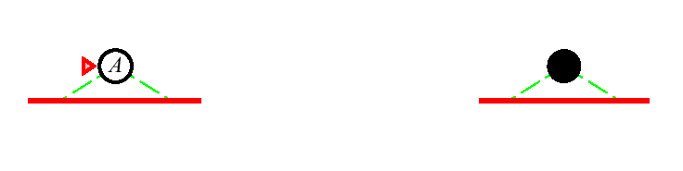
Iterative Deepening Search l = 0
Limit = 0

Slide 69

Iterative Deepening Search l = 1
Limit = 1

Slide 70
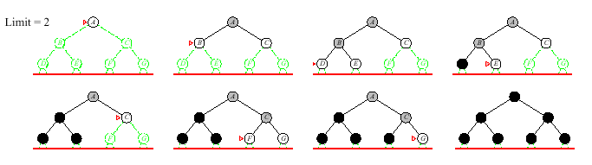
Iterative Deepening Search l = 2
Limit = 2

Slide 71
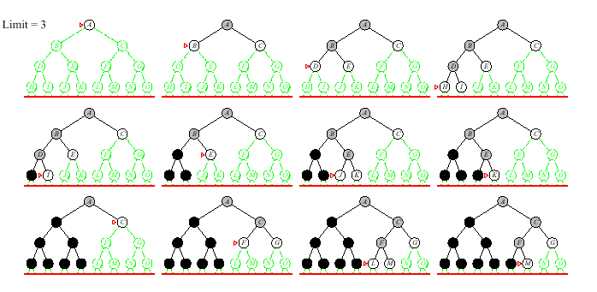
Iterative Deepening Search l = 3
Limit = 3
As can be seen, from the three iterations, the order of expansion of states is similar to BFS, except that some states are expanded multiple times

Slide 72
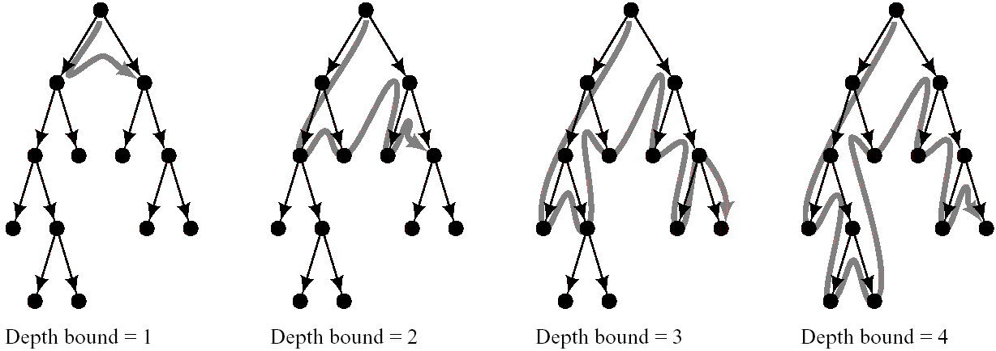
Iterative Deepening Search l = 1 to l=4
Stages in Iterative-Deepening Search

Slide 73
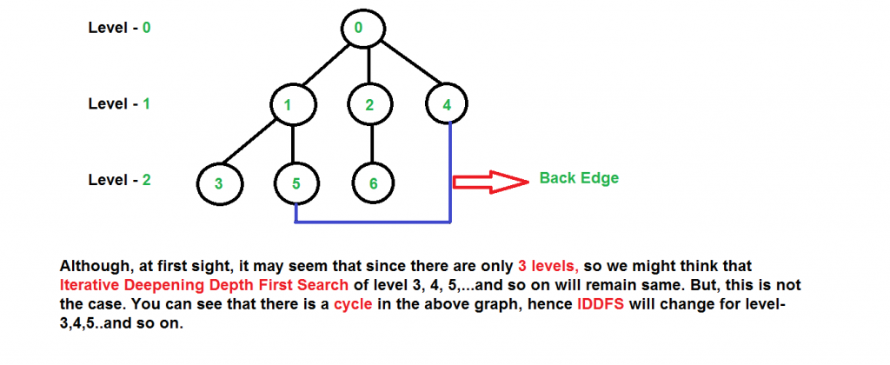
Iterative Deepening Search Ex. cont’d

Slide 74
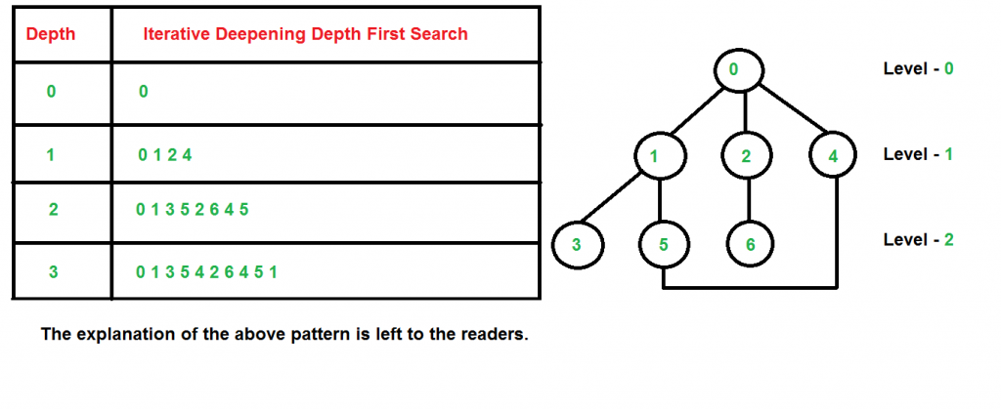
Iterative Deepening Search Ex. cont’d

Slide 75
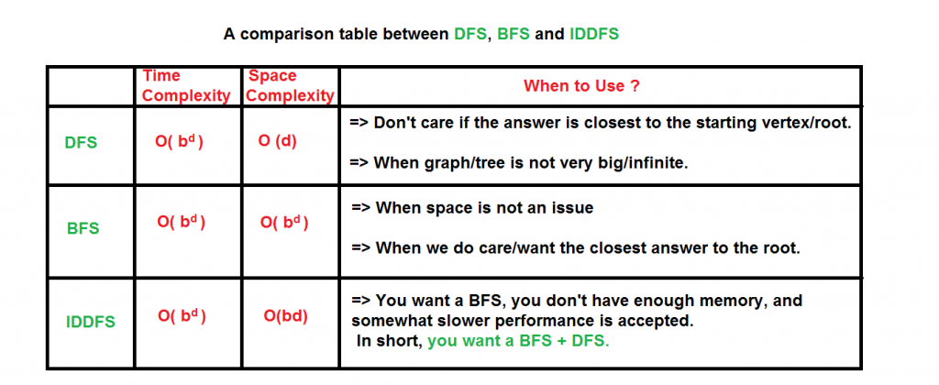
Iterative Deepening Search Ex. cont’d

Slide 76
Iterative Deepening Search (IDS)
It requires little memory (a constant times depth of the current node)
Is complete
Finds a minim-depth solution as does BFS
It is a strategy that avoids (sidesteps) the issue of choosing the best depth limit by trying all possible depth limits
Finds the best depth limit by gradually increase the limit -> 0, 1, 2, …until goal is found at depth limit d

Slide 77
Iterative Deepening Search Algorithm cont’d
1. DEPTH <-- 1
2. WHILE goal is not reached
DO perform Depth-limited search;
increase DEPTH by 1;

Slide 78
Iterative Deepening Search
Completeness
It is complete
It finds a solution if exists
Optimality
It is optimal
Finds the shortest path (like breadth first)
Guarantee shortest path
Guarantee for goal node of minimal depth

Slide 79
Uniform-cost search
Expand least-cost unexpanded node
Implementation:
fringe = queue ordered by path cost
Equivalent to breadth-first if step costs all equal
Consider the problem that moves from node S to G
S
A, 1
B, 5
C, 15
A
1
10
S
S
5
B
5
G
A, 1
B, 5
C, 15
15
C
5
G, 11
S
A, 1
B, 5
C, 15
G, 11
G, 10

Slide 80
Bi-directional Search cont’d
S
Forward
A
D
Backwards
B
D
A
E
C
E
E
B
B
F
11
D
F
B
F
C
E
A
C
G
14
17
15
15
13
G
C
G
F
19
19
17
G
25

Slide 81
Bi-directional Search cont’d
Bi-directional Search
Completeness: yes
Optimality: yes
Time complexity: O(b^{d/2})
Space complexity: O(b^{d/2})
Initial State
Final State
d / 2
d
O(b^{d}) vs. O(b^{d/2}) ? with b=10 and d=6 results in 1,111,111 vs. 2,222.

Slide 82
Comparing uninformed search strategies

Slide 83
3.5 Search and Optimization (Gradient descent)
We are faced with an initial situation and we would like to achieve a certain goal.
At any point in time we have different simple actions available to us (e.g., “turn left” vs. “turn right”). Executing a particular sequence of such actions may or may not achieve the goal.
Search is the process of inspecting several such sequences and choosing one that achieves the goal.
For some applications, each individual action has a certain cost. A search problem where we aim not only at reaching our goal but also at doing so at minimal cost is an optimization problem.

Slide 84
3.6 Dynamic Game Theory
It is a mathematical framework that enables us to model and analyze strategic interactions in dynamic and ever-changing environments.
The theory uses multiple players make decisions and take actions while considering not just their own interests, but also how the choices of others influence the overall outcome.
It has a significant impact in various fields, including economics, AI, and multi-agent systems,
it helps in understanding and optimizing decision-making in complex, interactive situations.
It allows intelligent systems to adapt and make strategic decisions in real-time, in response to changing circumstances and the actions of other agents.
It considers the dynamic nature of interactions,
It plays a crucial role in enhancing AI search and planning,

Slide 85
Key elements of dynamic game theory
1. Sequential Decision-Making:
Players make decisions one after another, and each player's choice is influenced by the choices made by previous players. This sequential aspect introduces a temporal dimension to the analysis.
2. Information Asymmetry:
Players may have varying levels of information about the game and other players' strategies. This can lead to complex strategies and strategic uncertainty.
3. Dynamic Strategies:
In dynamic games, strategies are not static but evolve over time based on the observed actions and outcomes, allowing for adaptation and learning.
4. Equilibrium Concepts:
Dynamic game theory extends equilibrium concepts from static games to incorporate the dynamic nature of interactions, such as subgame perfect equilibria, Markov perfect equilibria, and sequential equilibria.

Slide 86
Questions ?

